Slide 1
Replicated Data Service
By: Victor Fung
Shenghua You
Zheng Xian Huang

Slide 2
Background
Method of information sharing between multiple resources such as databases while maintaining information consistency.
Our Goal: to build an infrastructure to handle multi-clients to multi-servers traffic while maintaining database replication in a consistent and fault-tolerant way.
Setting: online banking system that allows simple functions such as deposit, withdraw, and check balance.

Slide 3
Modeling
Project Dependencies:
Languages:
Python 3
HTML/CSS
Databases:
Amazon Web Service Relational Database Service (RDS)
MySQL
Platforms:
Amazon Web Services EC2 - Amazon Linux AMI
MAMP for Mac OS
WAMP for Windows OS

Slide 4
The Front-End
Simple GUI webpage that the typical user will use to access
Give access to functions such as withdraw, deposit and check balance on their account.

Slide 5
The Middle
Controller, which controls the overall traffic
Contains algorithms to determine the order in which servers will get requests
Uses variable: average delay time per request
Goal: determine which server would be optimal to complete the current client request within the fastest time possible
Receives client requests and forwards them to servers
Receives response from the server and returns it back to the correct client.

Slide 6
The Back-End
Servers that interact with the databases and the replication process between the MySQL databases
Create the queries to query the master/slave databases, based on the type of request
Divide requests to master/slave or depending on request is a read or write query respectively.

Slide 7
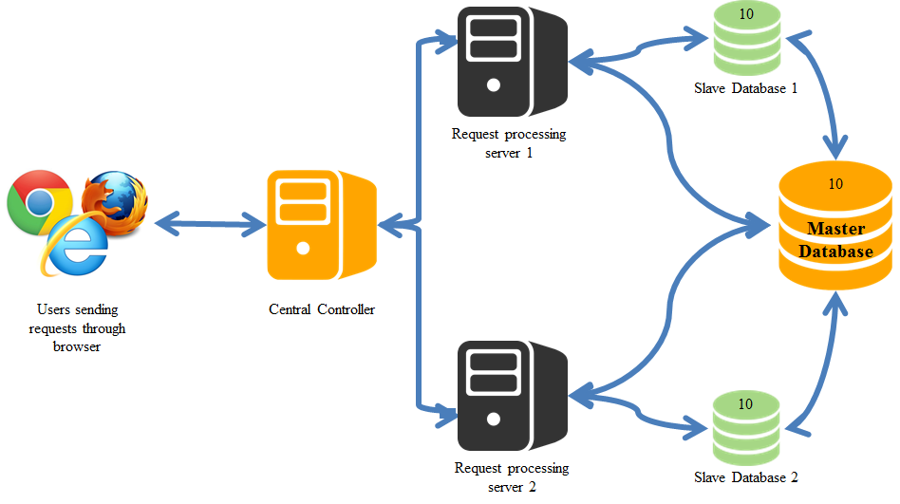
Bird’s Eye View of the Project

Slide 8
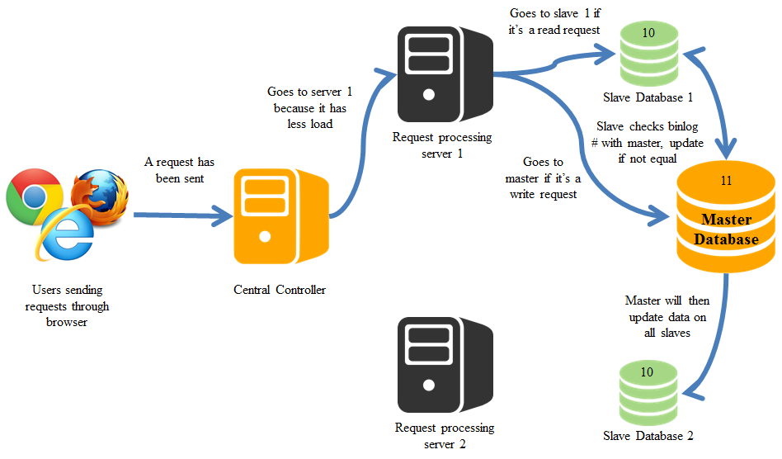
When Request was Sent...

Slide 9

When Request Finishes...

Slide 10
Replication on MySQL Databases
Master and Slave databases, what do we mean?
Master
An unique server identification number
Has binlog enabled
Configured to grant slave replication
Slave
An unique server identification number
Configured to request binlogs from the master

Slide 11
How does MySQL binlog work?
Records all MySQL statements with exception to specific query statements such as SELECT and SET
Each database state a bitwise binary image
Associated with a binlog position to keep track of master/slave database

Slide 12
What are its advantages and disadvantages?
Advantages | Disadvantages
Less data to transfer between the master and slave databases, meaning smaller update logs. Does not need to worry about row formats in the table. Inspecting changes to the databases is easier, as changes to the data are logged in the binlogs also, allowing us to see the current state of a database. | Nondeterministic behavior is difficult to replicate on database using statement-based replication. Issues with replicated store routined and triggers.

Slide 13
How was Race Condition Taken Care of?
Scenario 1: Bod and his wife Lisa has a joint bank account with total balance of $150. One day, they both decided to withdraw $100 from the account simultaneously at different location….
Scenario 2: While Bob is withdrawing $100 from the account, Lisa wants to check account balance...

Slide 14
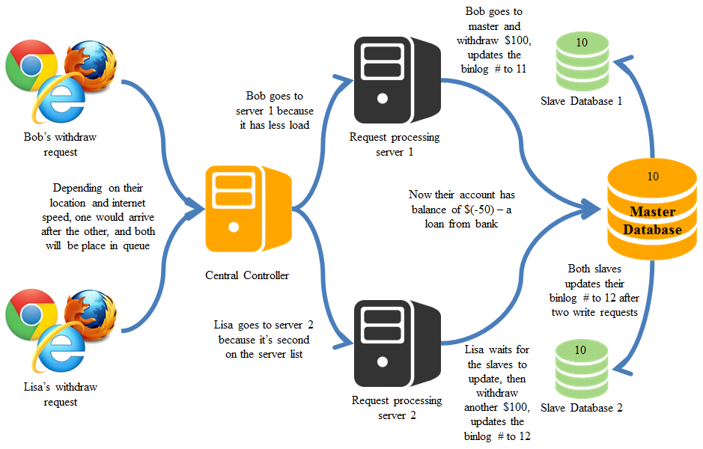
Scenario 1

Slide 15
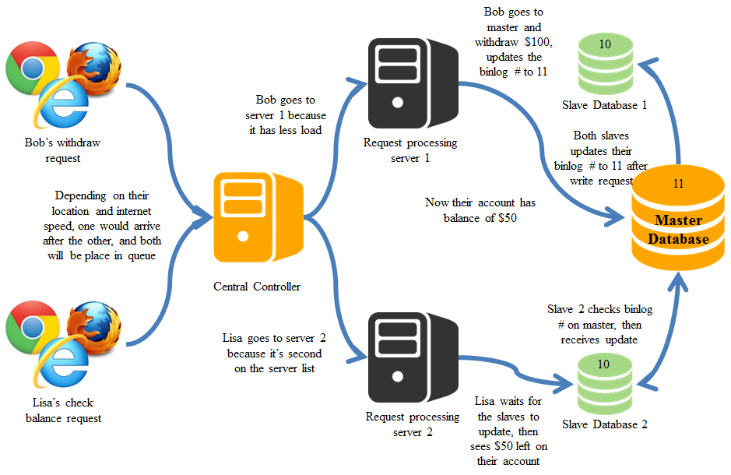
Scenario 2

Slide 16
How Do We Decide Server Order?
Our form of load balancer:
A thread on the controller will wake up every x secs to collect latency time from server.
Variable x depends on the size of requests in which our system will be handling, such that the more requests, the smaller x would be.
Latency time was calculated using the Leonard Kleinrock Formula.
The server list will be updated with the order of low to high latency time.

Slide 17
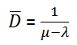
Leonard Kleinrock Formula
μ - avg delay time
𝜆 - # of requests per time interval
𝐷 - avg delay time per request

Slide 18
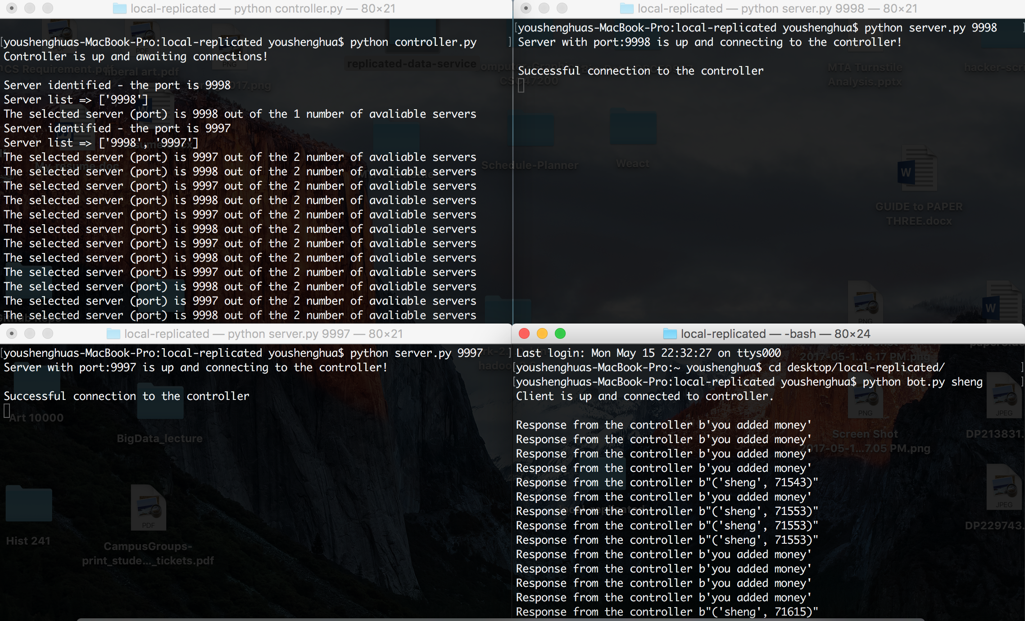
Screenshots

Slide 19

Thank You for Listening

